Slide 1
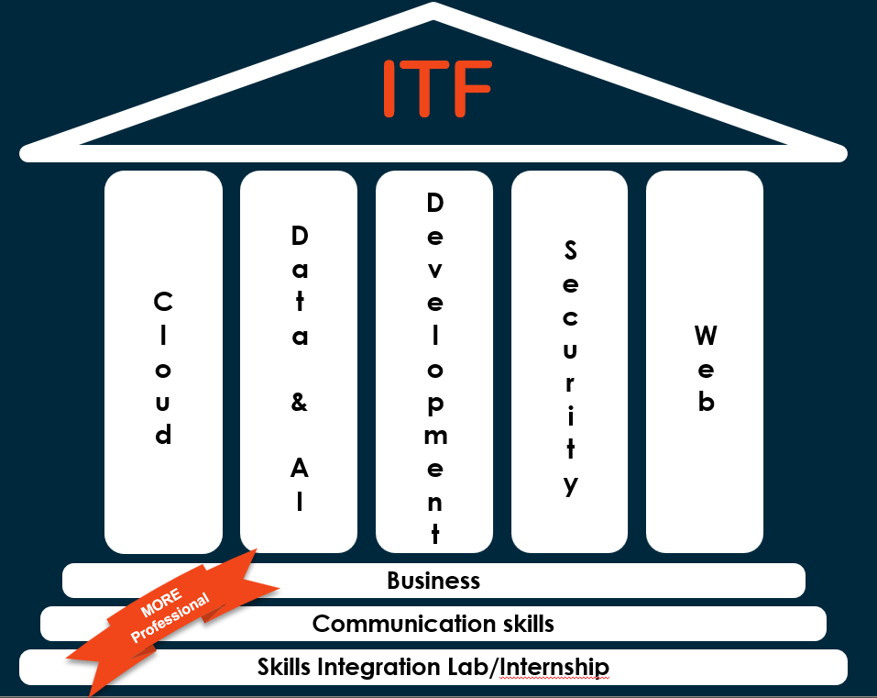
IT Factory
Data Science

Slide 2

IT Factory
Discover
Develop
Exceed your potential
Limitless growth in the digital world

Slide 3
ITF
Cloud
Data & AI
Development
Security
Web
Business
MORE
Professional
Communication skills
Skills Integration Lab/Internship

Slide 4
MORE Professionals
They Monitor their learning
Our students take their learning into their own hands in an effective way. They have both the skill set and the desire to constantly learn and master new things. They know themselves, what their strengths are and where there is still potential to grow.
They are Open to the world
Our students function within different context and regional settings of the world. They shift their perspectives and are open to other cultures, in order to communicate and cooperate effectively and appropriately.
They are Ready to act
Our students continuously adjust their actions from a reflective attitude .They work in a connecting and appreciative manner with others. They see opportunities, think out of the box and dare to take action to create added value.
They are Engaged in society
Our students are commited to create a positive impact on society. They are aware of how societal structures and systems can lead to inequality, injustice, … and can form an informed opinion about it.

Slide 5
ITF
Cloud
Data & AI
Development
Security
Web
Year 3: distinguish
Year 2: immerse
Year 1:
explore
Business
Communication skills
Skills Integration Lab/Internship

Slide 6
ITF
Cloud
Data & AI
Development
Security
Web
Year 2: immerse
Business
Communication skills
Skills Integration Lab/Internship

Slide 7
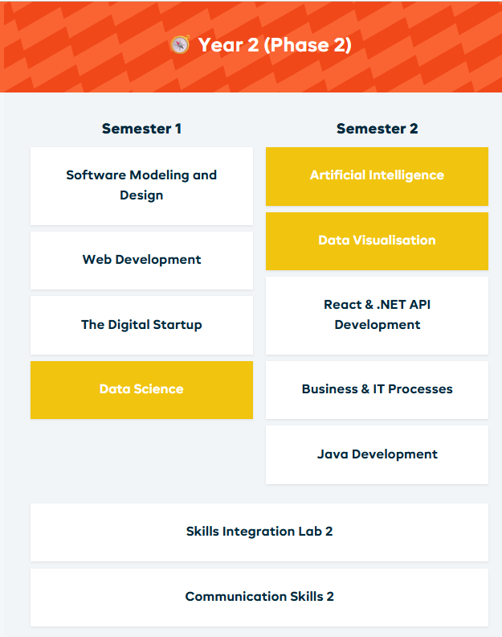
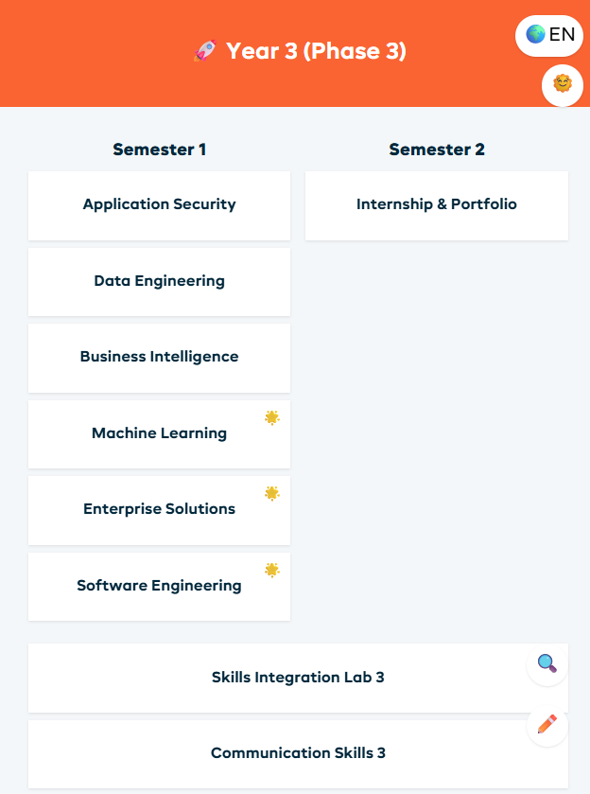
Data & AI
DATA track
Want to excel?

Slide 8
Chapter 0 – Teaching and learning arrangements
2025-2026

Slide 9
Learning outcomes
You dissect data from structured or unstructured (open) data sources;
You devise a method to convert data into a format suitable for further analysis;
You examine data to determine its most defining characteristics;
You conclude and advise based on in-depth analysis.

Slide 10
Classes and lecturers
Lecturers:
Jochen Mariën jochen.marien@thomasmore.be
Ellen Torfs ellen.torfs@thomasmore.be
Stef Van Wolputte stef.vanwolputte@thomasmore.be
Data Science counts for 3 credits
1 credit stands for 25h of work → 75h of job load (classes included)

Slide 11
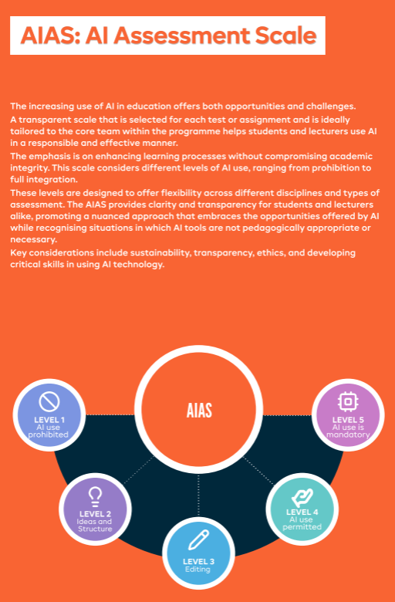

Evaluation: AIAS
LEVEL 4 AI use
permitted

Slide 12
Evaluation January
Individual project: 20%
Kickoff: during class in week 4
Deadline: 16/11 23:59
Based on chapters 2 + 3
The student scrapes data from the web, researches the data and presents the results.
As AI-based coding assistants can be used, the emphasis is on analysis and interpretation rather than correct syntax.
Assessment is based on explanation during an oral exam, not on the code provided in the solution.
Projects not submitted by the deadline will not be assessed.
Copying or having copied is considered exam fraud.
Be aware that your grades are retained for the 2nd chance exam in August

Slide 13
Evaluation January
Digital exam on own laptop: 80 %
The student analyses data by coding in Python and interprets the results.
question 1: Numpy & Matplotlib (30%)
question 2: Pandas (50%)
The exam is open book and open internet.
As AI-based coding assistants can be used, the emphasis is on analysis and interpretation rather than correct syntax.
The exam is taken on your own laptop. You are responsible for working hardware and software.
Communication between students is not allowed.
Copying or having copied is considered exam fraud.

Slide 14
Evaluation January
Realize that we are not just testing your programming skills!
During the oral defense of your project, you should be able to thoroughly explain the programming choices you have made. It is not enough that your code works. The emphasis is on understanding the code and interpreting the results correctly.
The same applies to the digital exam. You solve 2 exercises, but besides correct code, your analytical skills and understanding of the statistical output received are graded.

Slide 15
Evaluation August
Digital exam on own laptop: 80%
Continuous assessment points (individual project) are retained: 20%
Content of the exam is similar to that of the first exam opportunity.
The student analyses data by coding in Python and interprets the results.
question 1: Numpy & Matplotlib (30%)
question 2: Pandas (50%)

Slide 16
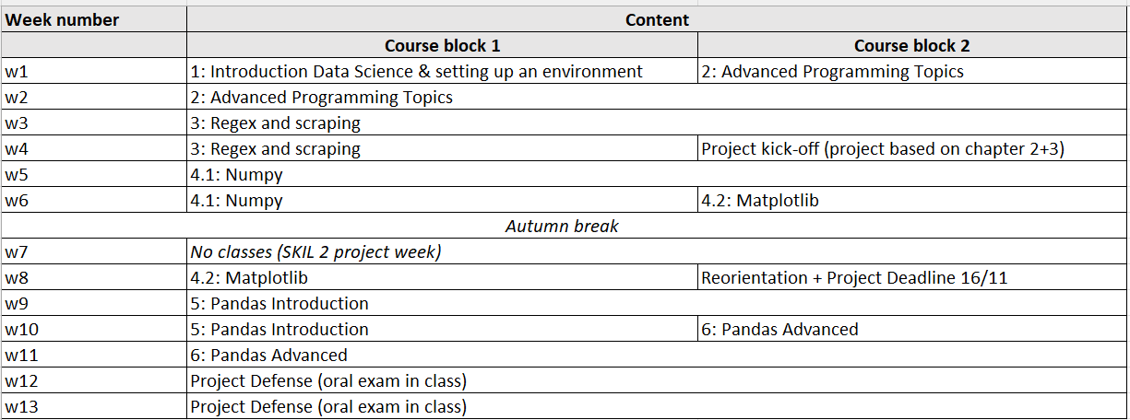
Course schedule

Slide 17
Course material on Canvas
Presentations
Contain all you need for the exercises and the individual project
Exercises
Solutions are not published but discussed in class
Individual project assignment
E-book
https://jakevdp.github.io/PythonDataScienceHandbook/
Chapters 1 - 4
Not mandatory reading, for support purposes only

